Slide 1

Criminal Weather
Analysis of Crime & Weather in the city of Denver
Melanie Nolker
Lisa Stroh
Kathy Nguyen
April Lagnevall
Haifa Najdawi
Notes:
Melanie

Slide 2
Motivation & Summary
Does weather have an impact on a crime?
Find if there is a correlation in non-traffic crime in the city of Denver compared to various weather conditions.
Hypothesis: Weather has an impact on non-traffic crime in Denver.
Null Hypothesis: Weather does not affect non-traffic crime in Denver.
Notes:
Kathy

Slide 3
Questions & Data
Is there a correlation between crime & weather?
What type of offenses will be used to analyze crime rates?
What weather conditions will be used to compare to offenses?
Datasets Used:
Crime data: https://www.denvergov.org/opendata/dataset/city-and-county-of-denver-crime
.csv file of Denver city crime from 1-1-2016 to 9-9-20
Weather data: https://www.worldweatheronline.com/developer/api/docs/historical-weather-api.aspx#qparameter
Weather API = API and pulls weather data for every day from 1/1/2016 to 8/31/2020
Pull multiple weather conditions
Notes:
Kathy - Crime
Haifa - Weather

Slide 4
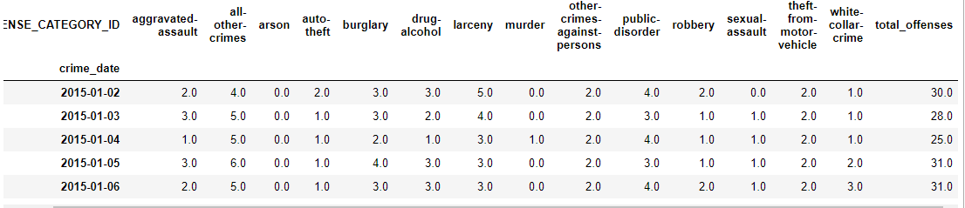
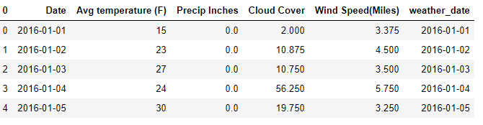
Data Cleanup & Exploration
Violent Crime:
filter for "Is Crime" = 1
Excluded traffic related offenses
Grouped .csv data by: Occurrence_date & Offense Type
Denver Weather:
Avg temperature (F) per day
Multiple values per day:
Sum of precipitation (inches)
Avg cloud cover (%)
Avg wind speed (mph)
Notes:
April – Crime
Lisa - Weather

Slide 5
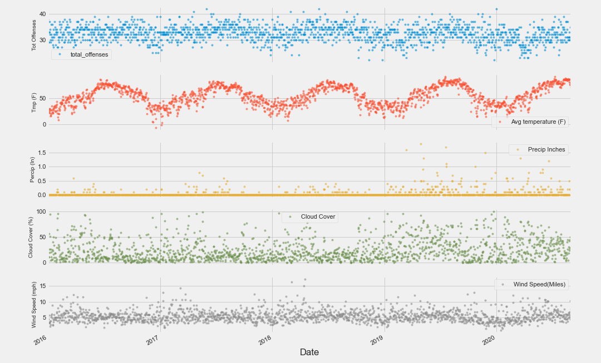
Data Analysis
Notes:
Melanie

Slide 6
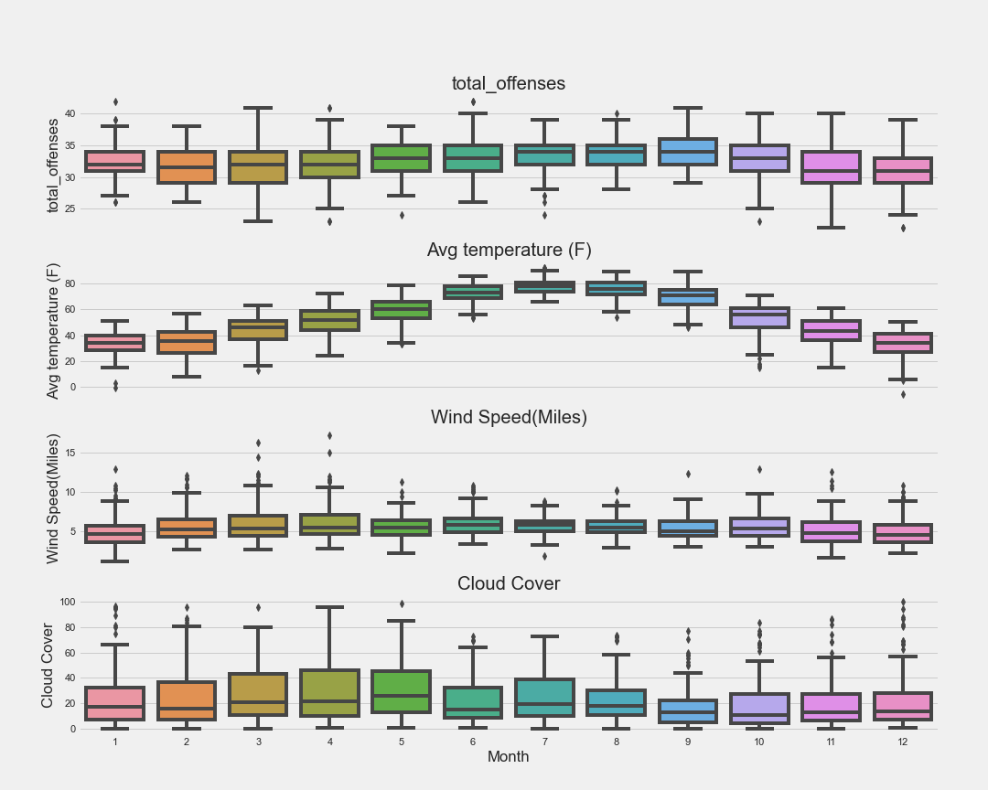
Data Analysis
<answer>
Discuss the steps you took to analyze the data and answer each question you asked in your proposal
Present and discuss interesting figures developed during analysis, ideally with the help of Jupyter Notebook
Notes:
Melanie

Slide 7
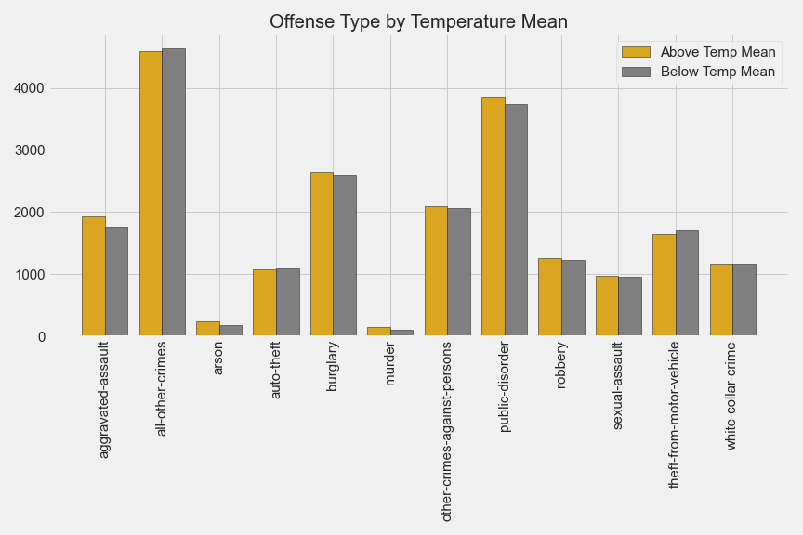
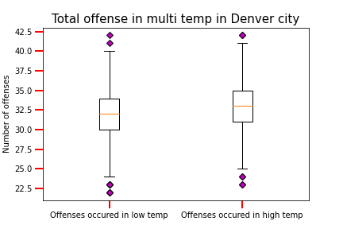
Data Analysis
Notes:
April

Slide 8
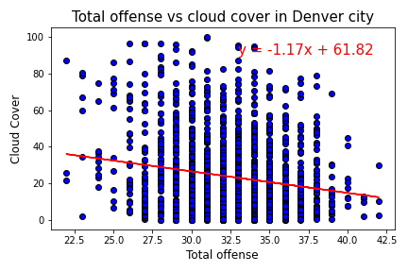
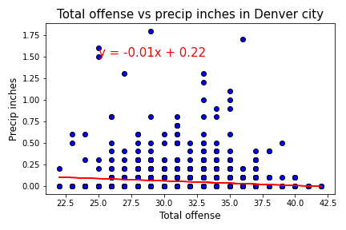
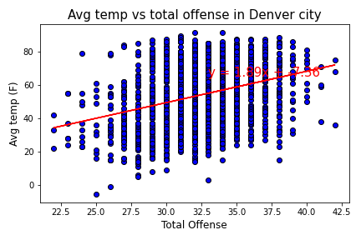
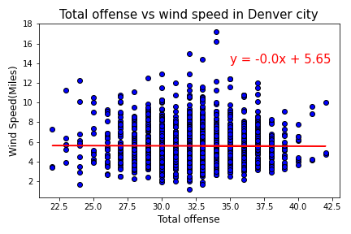
Discussion / Conclusion
Discuss your findings. Did you find what you expected to find? If not, why not? What inferences or general conclusions can you draw from your analysis?
P-values & r values
Notes:
Lisa first p-value
Haifa r values

Slide 9
Post Mortem
Difficulties
Finding a topic to research
Finding a free weather API that pulled historical data
Finding large enough amounts of crime data with dates for free to compare to the weather
Questions started leading us away from the original scope
Git Hub challenges…
Don’t use a blank .gitignore!!
It caused lots of unresolved conflicts.
Notes:
Kathy

Slide 10
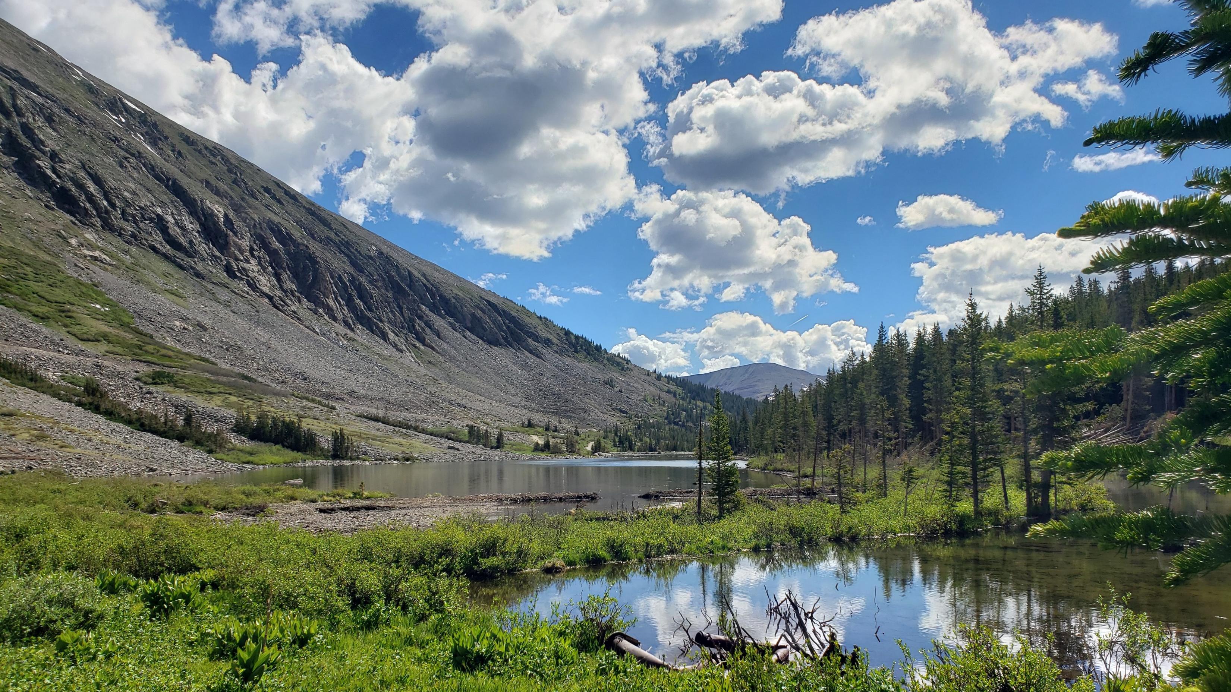
Questions?
Notes:
Melanie

